Slide 1
Using AIM (for Registered Students):
Student Life Disability Services
The Ohio State University
Last Updated 8/17/19

Slide 2
What is AIM?
Accessible Information Management (AIM)
Online portal for students registered with SLDS to receive accommodations.
Students registered with Disability Services use AIM to generate their Course Accessibility Letters and make accommodation requests each semester for Columbus campus courses.
NOTE: To ensure that you do not miss important emails sent via AIM, we encourage you to either:
Add the domain "post.accessiblelearning.com" to your safe sender list (click here for Outlook 365 instructions), or
Regularly check your junk mail folder.

Slide 3
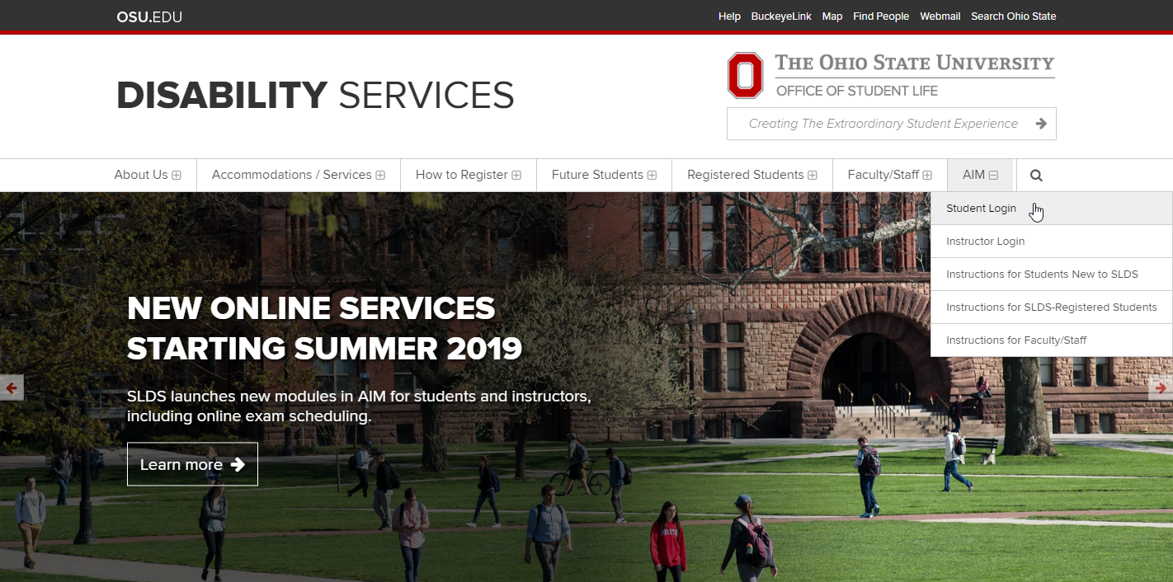
Login to AIM
Each semester, you will need to Log in to AIM to submit your accommodation requests.

Slide 4
Your dashboard may notify you of e-agreements that you need to sign. Please review these documents and acknowledge them using the prompts on the screen.

Slide 5
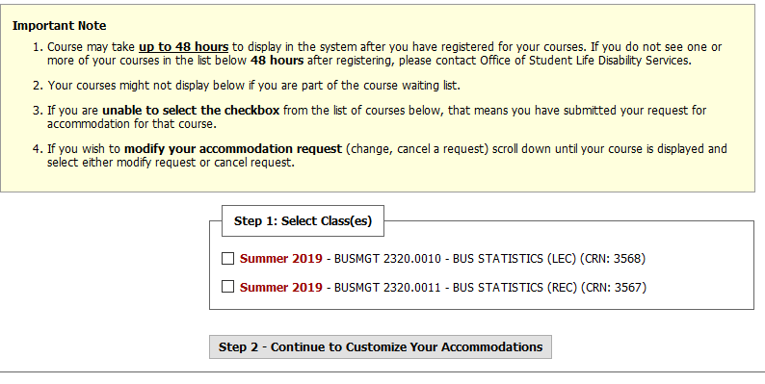
You should now see a list of your enrolled courses. If you do not see one or more of your courses, please contact SLDS.

Slide 6
Select each course in which you are requesting accommodations. Then, click the button “Step 2 – Continue to Customize Your Accommodations”

Slide 7
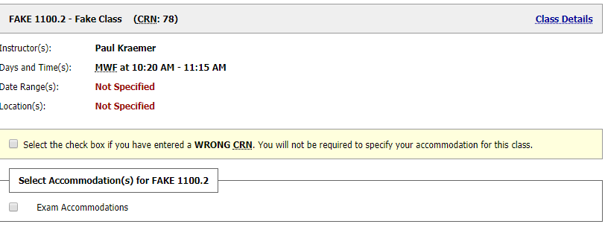
Reminder: Generating Letters and Requesting Exam Accommodations in a Course
When generating Course Accessibility Letter, be sure to select Exam Accommodations if you would like to take your quizzes or exams with accommodations at SLDS

Slide 8
For each course, select all of the accommodations that you are requesting. This checkbox feature allows you to create customized letters for each course! When finished, click the button “Submit Your Accommodation Requests.”

Slide 9
The letters will be emailed to you and your instructor(s). You may also choose to download a PDF copy of the letter by selecting the course from the dropdown menu at the top of the page, then selecting "Generate PDF." Downloading a PDF copy is optional. If you have any concerns with this information being shared with instructors via email, please speak with your Access Specialist.

Slide 10
IMPORTANT REMINDERS:
Now that your letters have been sent, be sure to: (1) discuss your accommodation requests with the relevant faculty/staff, (2) complete any remaining accommodation procedures (as described in the Student Handbook), and (3) contact SLDS with any questions or concerns.
Remember: The accommodations of some common courses are coordinated partially or entirely by a course coordinator. It is important for you to know these contacts and follow up as needed with them. Please review the Common Courses - Contact List page for more information.
NOTE: If you make any changes to your accommodation selections after the first time you generate a Course Accessibility Letter, you will not be able to generate the revised letter without approval from SLDS. These approvals typically take 1 business day to process.

Slide 11
Next Steps, Continue Reading
Continue reading this PowerPoint for next steps for the following accommodations (if eligible):
Requesting note-takers or attendance/deadline modifications,
Submitting accessible media requests,
Scheduling exams in AIM

Slide 12
Requesting Note-Takers or Attendance/Deadline Modifications (if eligible)
Your Course Accessibility Letter will briefly describe the purpose of these accommodations, as well as direct the instructor to our Supplemental Accommodation Instructions page. Your instructor should read the supplemental instructions to understand how to implement these accommodations in their courses.
For requesting note-takers: The instructor is responsible for providing your name and email address to the identified note-taker, as well as directing the note-taker to our “Note-Taker Instructions” page.
For requesting attendance/deadline modifications: Please review the guidance and resources available on our “Instructions for Students Requesting Attendance/Deadline Modifications” page.

Slide 13
Submitting Accessible Media Requests (if eligible)
Sending your Course Accessibility Letter does NOT automatically send a material conversion request to SLDS.
You still need to send all material conversion requests to slds-altmedia@osu.edu with appropriate advance notice (ideally one semester in advance, immediately after registering for classes).

Slide 14
How to schedule exams in AIM:

Slide 15
Overview of Alternative Testing Process
(Optional) Instructors or Course Coordinators can proactively fill out the Testing Agreement using the Instructor Portal at beginning of semester.
Student requests accommodations for a course using the AIM portal. AIM automatically generates an email to the instructor with the Course Accessibility Letter attached. If exam accommodations were requested and no Testing Agreement is on file, a link to the form is included.
Student submits their specific exam scheduling requests in AIM.
Disability Services staff cross-reference student exam requests with Testing Agreements. Student receives a confirmation email when a request is approved/denied. If no Testing Agreement is on file, Disability Services follows up with the instructor.
Disability Services sends consolidated reminder emails to instructors and course coordinators (one email per recipient) to submit materials for an upcoming exam. Materials uploaded to AIM can be assigned to a specific student or to an entire section.

Slide 16
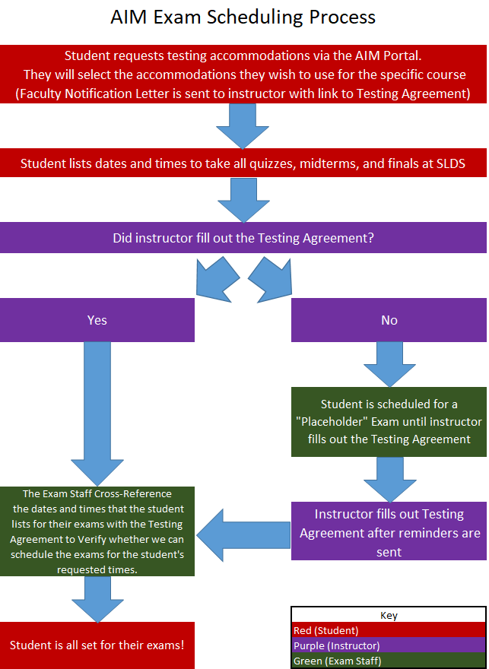
Alternative Testing Flowchart

Slide 17
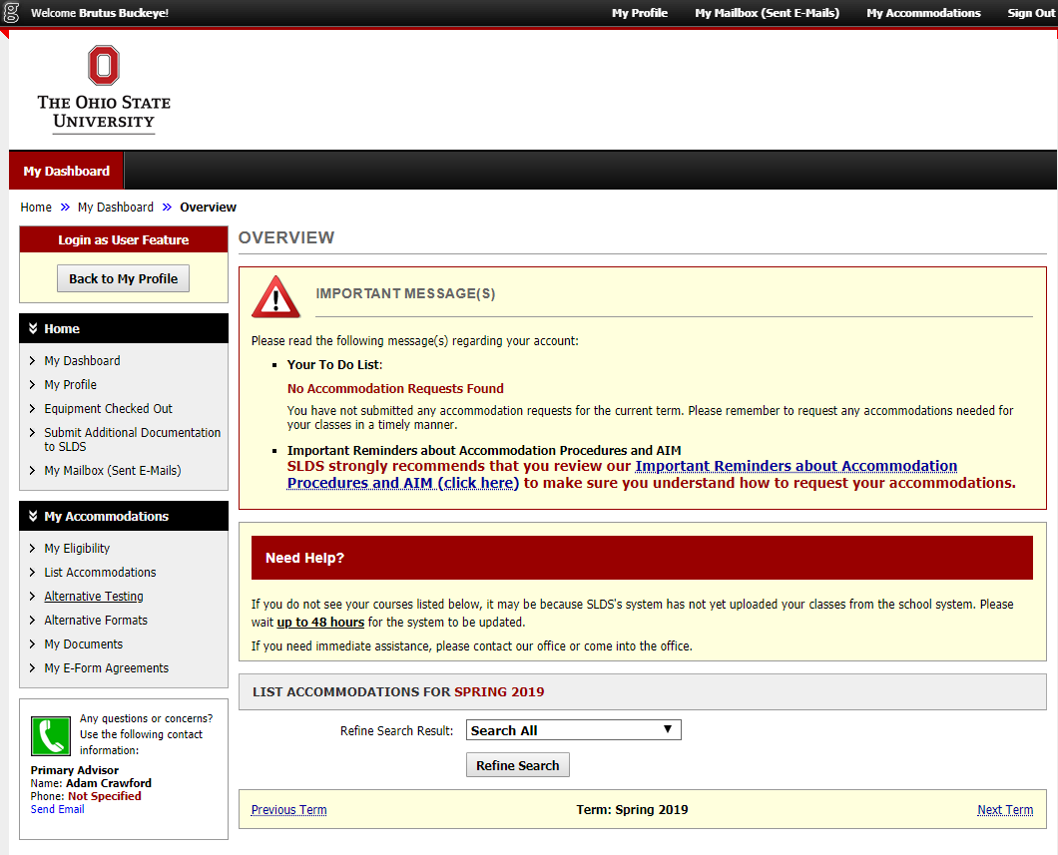
Navigating to Alternative Testing Module
On the left side of your screen, you will select Alternative Testing

Slide 18
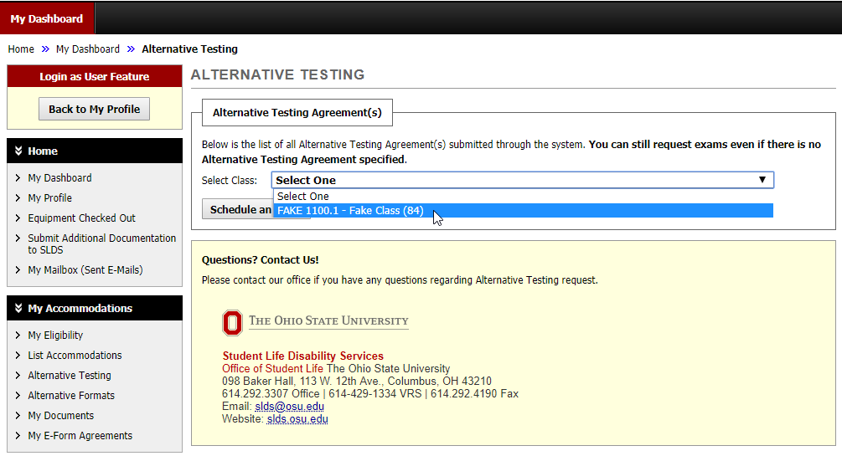
Selecting a Course for Exam Scheduling
Select the class for which you wish to schedule a quiz or exam at SLDS, and click “Schedule an Exam”

Slide 19
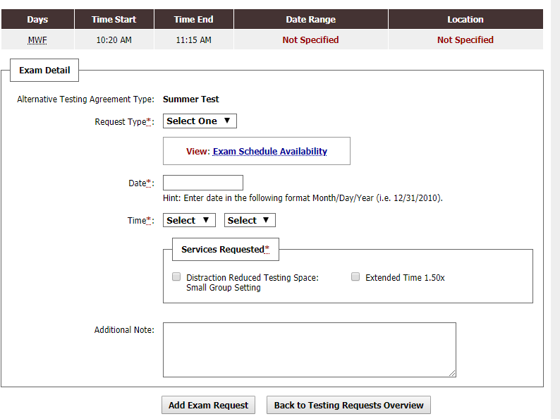
Scheduling Individual Quizzes/Exams
This will lead you to the Exam Detail, where you will fill out the type of exam, date, time, and accommodations you wish to use (please note, only select the accommodations you wish to use for that specific exam)

Slide 20
After Submitting a Scheduling Request
You will receive an email either approving your exam request, or asking you to contact our office due to your request not complying with the rules your instructor specifies
You can check the status of all your exams at any point by logging in to AIM and selecting the Alternative Testing tab

Slide 21
Final Exams
During the University’s Finals Week, SLDS uses block scheduling with 4 start times: 8 a.m., 11 a.m., 2 p.m., 5 p.m. Discuss your final exams schedule with your instructors. Select the agreed upon date and start time for your finals.
When you request a final exam, it will be listed as “approved” and is subject to change. You will receive your finalized date/time/location no later than 2 weeks before the 1st day of Finals Week.
In order to coordinate all testing accommodations during Finals Week, Disability Services reserves the right to move a final exam to either of the two closest start times on the same day.
Students will receive a confirmation email of their final exam dates/times/locations no later than 2 weeks prior to the first day of Finals Week.
For students approved for double time: Please be aware that the start times for your finals may be slightly adjusted by Disability Services to fit our modified block schedule for double time (8 a.m., 12 p.m., 4 p.m.). Your modified start time will be communicated to you via email, along with your date and location, no later than 2 weeks prior to the start of Finals Week.

Slide 22
Alternative Testing Agreement
If your instructor has not filled out the Alternative Testing Agreement by the time you schedule your exams, you will be notified via an automatic email
SLDS sends reminder emails to instructors to fill out their agreements. You may want to remind your instructor to fill out the agreement as well.
The Testing Agreement will allow SLDS to compare your requested times with those approved by the instructor
It will also inform us of any necessary information for our office to proctor your exams.

Slide 23
Checking Exam Status
At any time, you can check the status of all your exam requests by logging into AIM using your OSU credentials
You will select the Alternative Testing tab on the left side of the screen to view all of your exam information
SLDS will send reminders to your OSU email in advance of all of your exams, informing you of the dates and times

Slide 24
Day of the Exam
The proctoring of exams is not planned to be different from current methods
You will still report to our office to take exams, show ID, and we will contact your instructor about any questions you may have.

Slide 25
Questions?
If you have any questions, please feel free to call us at 614-292-3307, or email us at slds@osu.edu.

